Slide 1

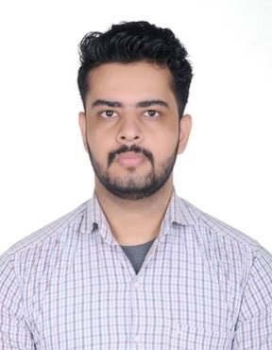





Ayush Kumar Malan
Education and certificates
Bachelor of Technology Computer Science : 2017 - 2021
Analyst/Software Engineer
Skills
MVC
ASP.Net Web API, ADO.NET
Python
Base Location: ^{Pune}
Email ID:
ayush.kumar-malan@capgemini.com
_{Mobile No:} +91 7011754616
Grade:
A4
Backend
REST-API
Strengths
A self driven learner with Front-End and Back-End knowledge. Passionate about implementing and launching new projects.
Ready to learn new technologies/Frameworks and implement them to further improve my knowledge.
A team player with good communication skill always ready to work for the enrichment of knowledge.
Has working knowledge on ASP.NET Web AP, MVC and Python on an intermediate level.
Projects and Achievements
PIMS (Project and Idea Management System)
Worked as a backend developer in PIMS project. Have created methods and API’s for the application. Also worked on test cases creation for manual testing.
Awarded with performer of the quarter for this project.
Database
SQL database – MySQL, Oracle
College Management System
Web Technologies
HTML5
Angular
Developed a website named college management system that has records of colleges , their courses and details of their students. Used MVC Framework, HTML for front end design.
AddOns Github Postman
Also have basic knowledge of SQL language and angular in frontend
Additional Details
Excellent Communication Skills
Team Player
Presentation Title | Author | Date © Capgemini 2017. All rights reserved | 1

